Slide 1
Period 2 Review (1607 - 1754) in 10 Minutes
Everything You Need To Know About Period 2 To Succeed in APUSH

Slide 2
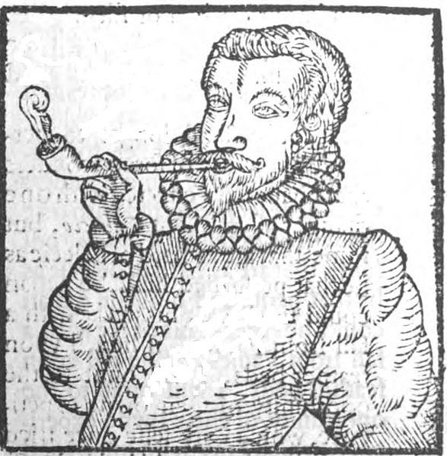
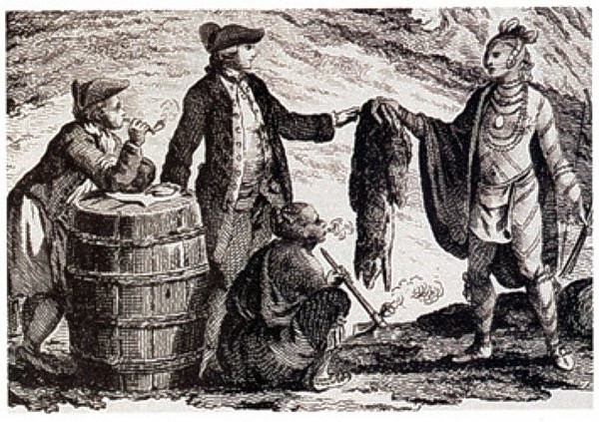

European Imperial Goals
Spanish:
Tight control, sought to convert Natives and gain gold
Dutch and French:
Sent fewer settlers, established trade alliances with Natives, often intermarried, traded furs
English:
Colonies heavily relied on agriculture (tobacco - Chesapeake), many men and women populated the colonies, often hostile relationships with Natives

Slide 3
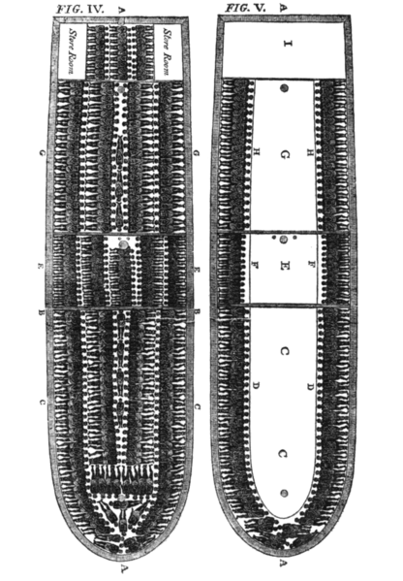
British Colonies
British colonists rarely intermarried with Natives and Africans
Rigid social hierarchy developed
Emergence of the Atlantic Slave Trade was caused by:
Racial superiority, lack of indentured servants (post-Bacon’s Rebellion in 1676), Natives were harder to enslave, and European demand for goods
Impacts of African Slavery?
Desire for more land - conflicts with Natives
Africans used covert (passive) and overt forms of resistance

Slide 4
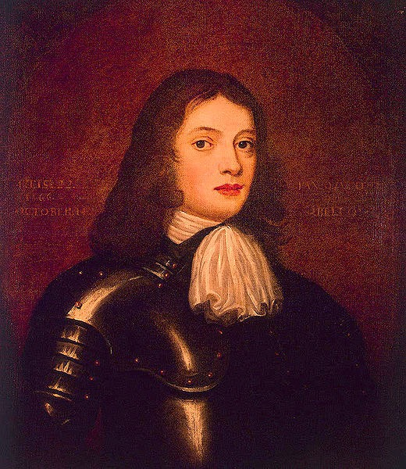
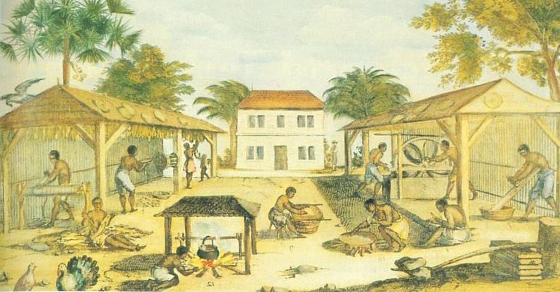
British Colonies
New England:
Puritans that sought to establish a like-minded (homogeneous) community
Mixed economy - agriculture and trade
Longer life-expectancy, more families
Middle Colonies:
Religiously, ethnically, and demographically diverse
Crops - cereal (grains)
Southern:
Chesapeake (MD and VA) and North Carolina - tobacco - labor-intensive
Relied on indentured servants initially, later slavery (Post-Bacon’s Rebellion)
Atlantic seaboard (South Carolina) and West Indies:
Long growing season, heavy use of slave labor
Staple crops - (rice), as well as sugar
Slaves often made up most of the population

Slide 5
European Conflicts in the Americas
Colonies focused on goods that were valued in Europe (fur, tobacco)
Colonists had different goals than European leaders:
Helped promote mistrust
Colonists were upset over:
Territorial settlement, frontier defense

Slide 6
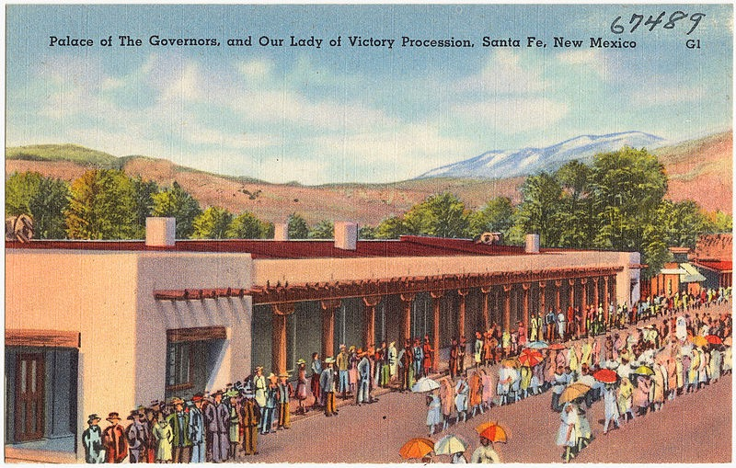
European and Native Clashes
Diseases ravaged Native communities
Pueblo Revolt (1680):
Spanish sought to suppress Native practices inconsistent with Christianity
Pueblos revolted, expelled the Spanish for over 10 years
The Spanish regained control, advocated the religious assimilation of Natives
Native American Warfare:
Became more destructive due to:
Deadlier weapons (guns) and alcohol

Slide 7
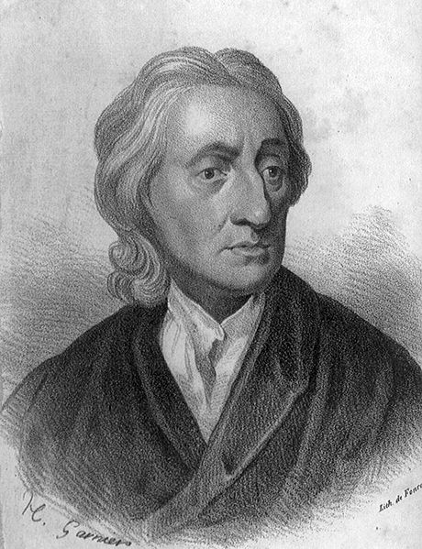
Impacts of Exchanges on North America
Exchange of European and New World goods increased significantly
Slaves, tobacco, rice, etc.
Anglicization of the British colonies:
Trans-Atlantic print culture, Protestant evangelism, Enlightenment, etc.

Slide 8
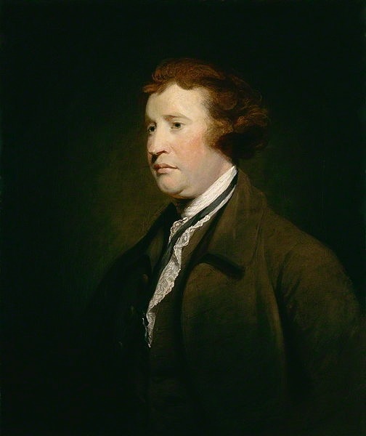
British-Colonial Relations
Similar laws, cultures, institutions, and government developed within the British colonies
Britain sought mercantilist policies:
Making $ for the Mother country
However, this was not always successful:
Colonial resistance - smuggling
Britain’s policy of salutary neglect - British indifference
Colonial arguments for resistance?
Self-government, lack of representation
Enlightenment ideas - liberty
Religious independence and diversity - less importance of Anglican Church
Perceived corruption in British imperial system

Slide 9
Quick Recap
Spanish, French, Dutch, and English imperial goals and relations with Natives
Reasons for Atlantic-trade and increase in slavery
British colonies - economy, population characteristics
Colonial v. Imperial goals
Pueblo Revolt
Early resistance by British colonies

Slide 10
Short Answer Practice
Answer all 3 parts:
a) Briefly explain one goal of English colonization
b) Briefly explain one English goal that differed from other European powers
c) Briefly explain one impact of English colonization in the Americas

Slide 11
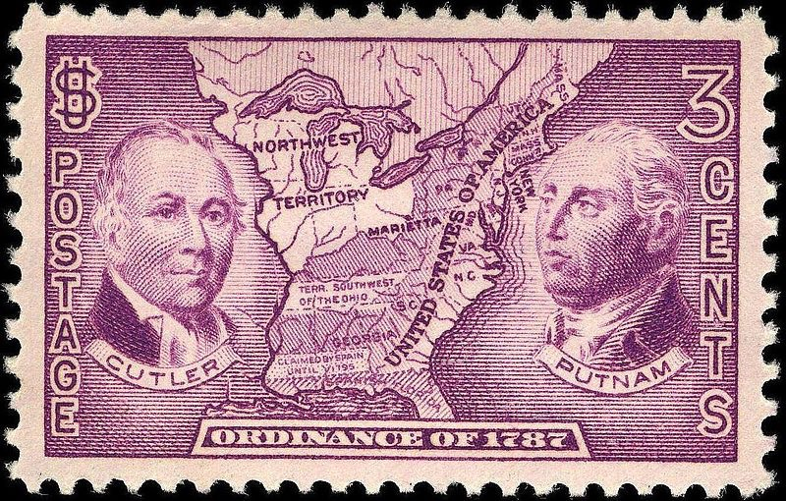
See You Back Here For Period 3 In 10 Minutes!
Thanks for Watching
Please subscribe, share with others
Check out all my videos related to the new curriculum
Best of luck on all your tests!

